Slide 1
Rating Prediction
By: Sushil Joshi

Slide 2
Problem Statement
We have a client who has a website where people write different reviews for technical products. Now they are adding a new feature to their website i.e. The reviewer will have to add stars(rating) as well with the review.
The rating is out 5 stars and it only has 5 options available 1 star, 2 stars, 3 stars, 4 stars, 5 stars. Now they want to predict ratings for the reviews which were written in the past and they don’t have a rating.
So, we have to build an application which can predict the rating by seeing the review.Here, we need to make a model which can predict ratings using reviews of the product.

Slide 3
Data sources and formats
We scraped the dataset of various products such as mobile phone, printer, smart watches, laptop, earphones etc., from different websites such as amazon, flipkart, myntra.
The dataset consists of 20751 rows and 4 columns.

Slide 4
Problem Solving Approaches
Below is the method that we use in solve the issue and make the best model:
Data reading and understanding
Data cleaning
Data analysis
Data preparation
Over sampling
Train test split
Machine learning algorithms

Slide 5
Data cleaning
For cleaning and pre-processing we used some techniques to do so:-
Dropped Unnamed:0 column, as it was just an index number, which will not help in detecting the ratings of the product.
We checked for the null values, and there were no null values present.
We checked for the counts of the ratings which were numbered as 1, 2, 3, 4 and 5. But the count of the numbers were not balanced, we used smote technique to balance it.
After data analysis, we prepare our data using NLP (Natural Language Processing). We convert review column in lower case and remove punctuation from that column like +, - , /, etc. because that type of punctuation badly affect out result. We also remove digits from our review column.
At last, we use stop words, lemmatization, tf-idf and smote techniques for preparation of the data, which we already discussed above.

Slide 6
Data preparation
After data analysis, we use some NLP (natural language processing) techniques for data preparation which is listed below:
Convert review column in lower case
Remove punctuation from review column
Remove digits from review column
Remove stop words
Lemmatization
Term Frequency-Inverse Document Frequency (TF-IDF)
Oversampling (Smote)

Slide 7
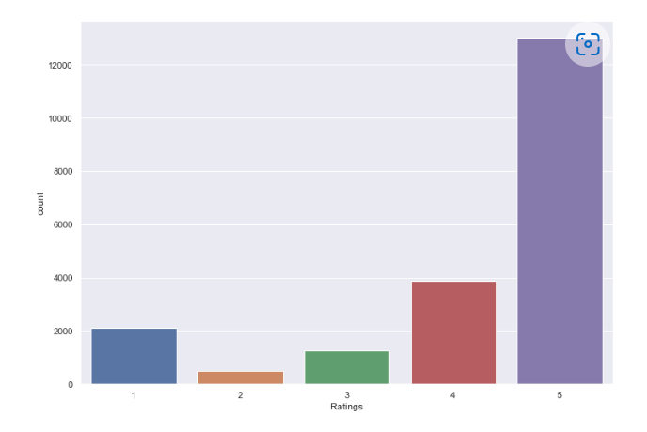
Data Analysis
In this bar plot we can clearly see that the count of rating 5 is the maximum followed by rating 4.
1,2,3 rating counts are the less as compared to other two ratings. We can reduce from the plot that people mostly tend to rate at extremities i.e., 5 if the product is good and 1 if the product is bad.

Slide 8
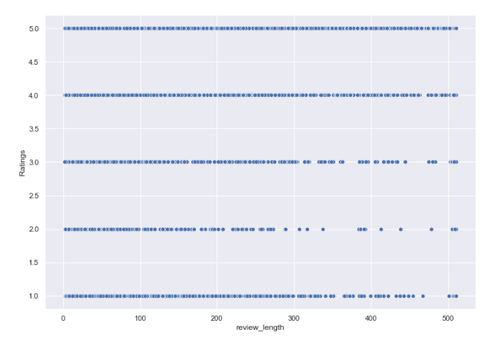
From the scatterplot we can see that the higher ratings have higher review length.

Slide 9
Train test split
we split our dataset into two segments: training and testing. We take 90% data for training and 10% data for testing. For splitting data we use train test split method. Below is the code for splitting the data:
90% of the observation as training set-x_train
The associated target for each observation in x_train - y_train
10% of the observation as test set- x_test
The target associated with the test set-y_test.

Slide 10
Testing of identified approaches
The classification algorithm that we used is:
Logistic Regression
Decision tree classifier
MultinomialNB
Random Forest Classifier
Support vector Classifier

Slide 11
Building machine learning model
We used 5 algorithms to test our model and out of which one model turned out to be the best model, we will be describing the best model here.
Random Forest model turned out to be the best model here. It comes under supervised learning. The algorithm generally generates hundreds or thousands of individual trees.
The "forest" it builds, is an ensemble of decision trees, usually trained with the “bagging” method. The general idea of the bagging method is that a combination of learning models increases the overall result.
This classifier produces multiple decision trees and merges them together to produce accurate result.

Slide 12
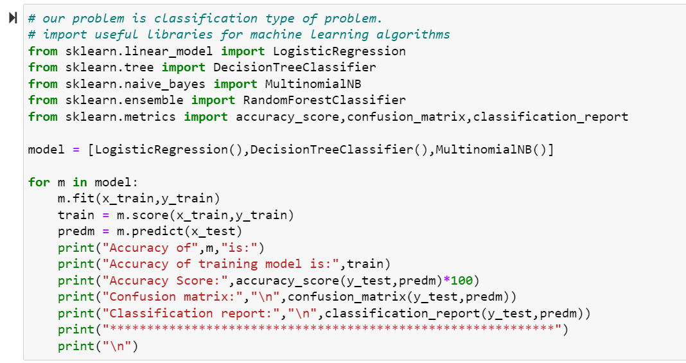

Slide 13
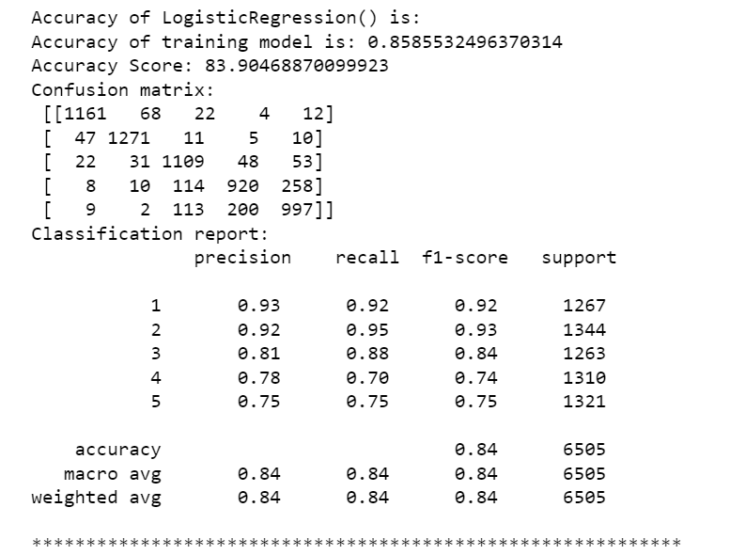

Slide 14
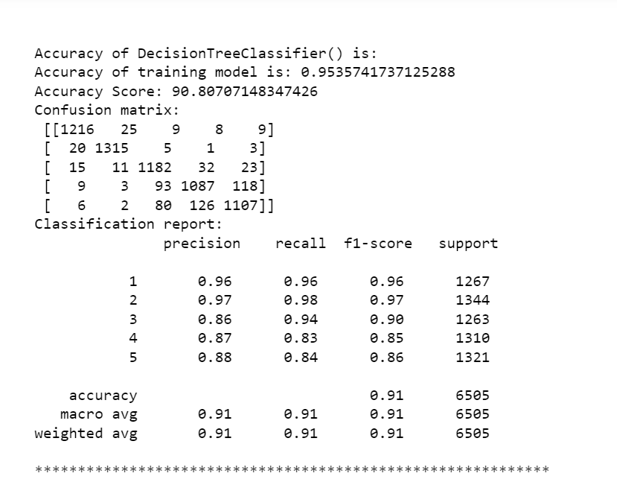

Slide 15
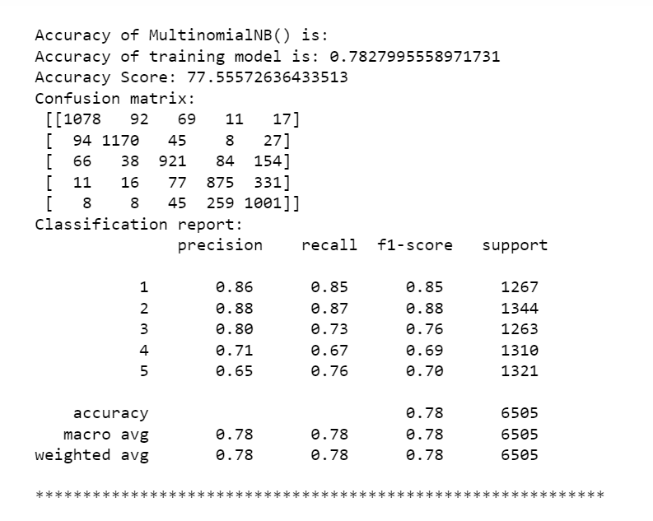

Slide 16
Conclusion
The reason for this article was make prescient model ready to adequately characterize evaluations dependent on reviews of various items.
Our target variable is imbalanced, so we use SMOTE procedure to get a decent outcome.
We utilize numerous classifiers to see as best model and best outcome were noticed for the DicisionTreeClassifier with 90.8% accuracy.
By utilizing this model our customer effectively gets the appraisals from surveys.

Slide 17
Thank You

